Slide 1
Angry Birds Alike
Presented by: Hossain, Al Jubair

Slide 2
Overview
A game based on intermediate and heightened physics mechanisms having Force, Velocity, Elastic Collision and Momentum Transfer.
Providing mathematical formula to solve trajectory like using Runge-Kutta4 method.

Slide 3
Overview of Technologies
SFML (Simple and Fast Multimedia Library): Used for window management, graphics, and events.
Boost.odeint: A C++ library for solving ordinary differential equations (ODEs), used here to simulate physics.
C++ Standard Library Features: Arrays, cmath for mathematical functions, chrono for time management, thread for threading.

Slide 4
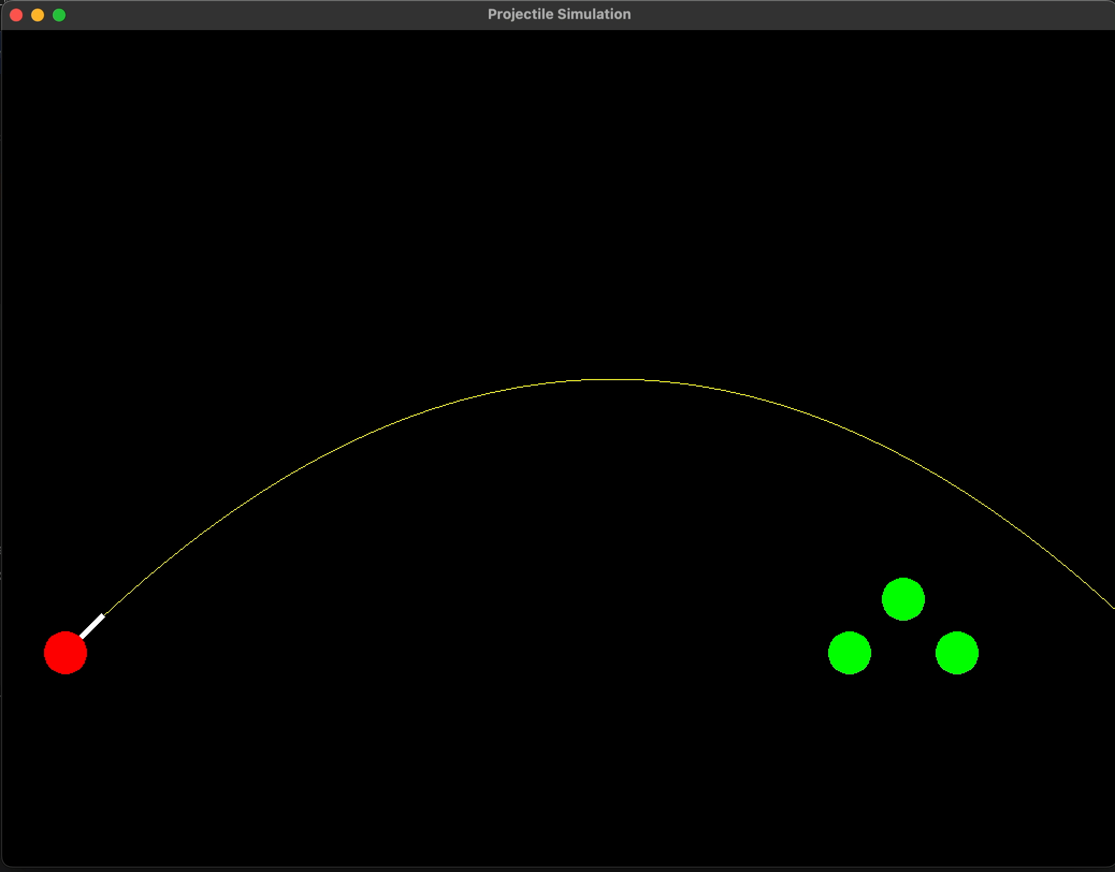
Projectile System Walkthrough(Demonstration)

Slide 5
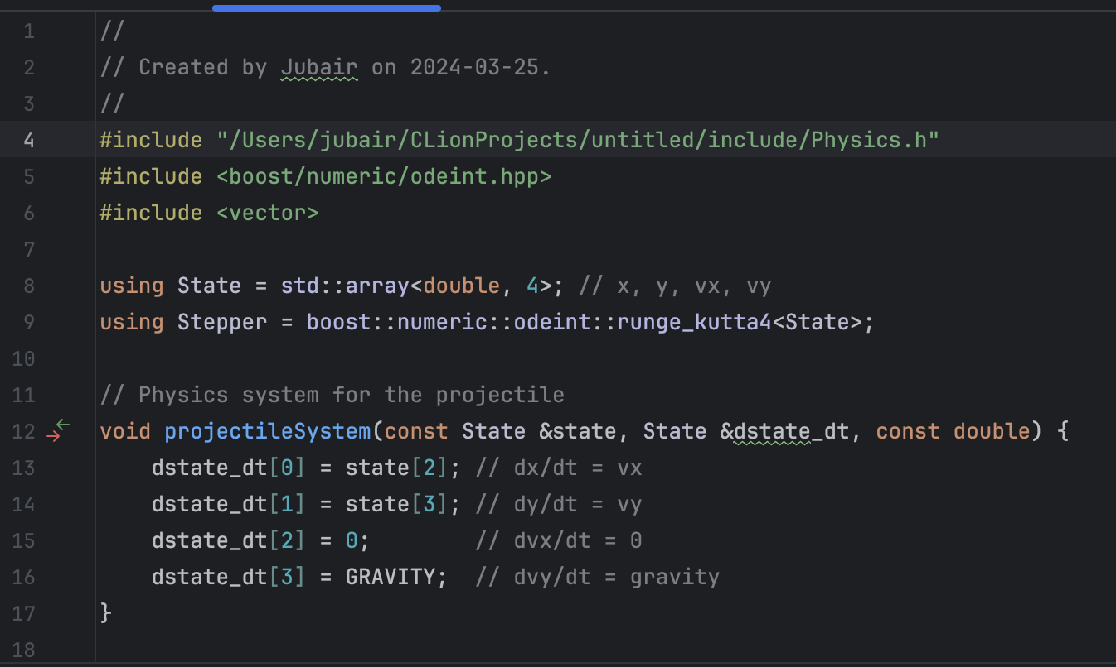
Projectile System Walkthrough

Slide 6
Projectile System Walkthrough
The Runge-Kutta 4th order method (RK4) was utilized to determine the projectile's trajectory by calculating the distances covered based on the applied force and resulting velocities.
Getting - dx​/dt=vx​, dy/dt​=v_{y}​, dv_{x}/dt​​=0 dv_{y}/dt​​=g
where g is the acceleration due to gravity (−9.81m/s2 or −981cm/s2 for consistency with the code).
Assuming an initial state at time t₀​ with x₀​=0, y₀​=0, v_{x0}​=10m/s, and v_{y0}​=10m/s, and we want to find the state after a small timestep of Δt=1s.

Slide 7
Projectile System Walkthrough
The Runge-Kutta 4th order method (RK4) was utilized to determine the projectile's trajectory by calculating the distances covered based on the applied force and resulting velocities.
Simple example :- Step 1: Calculate the four "k" values
k₁​ values are the derivatives at the beginning of the timestep:
k_{1x}​=v_{x0}​=10
k_{1y}​=v_{y0}​=10
k_{1vx}​=0
k_{1vy}​=g=−9.81

Slide 8
Projectile System Walkthrough
After calculating slopes for k₂, k₃, k₄ ,we proceed to step 2. Step 2: Update the state
The new state is computed using a weighted average of the four k values, with greater weight on the midpoints:
x_{new}​=x₀​+Δt/6​(k_{1x}​+2k_{2x}​+2k_{3x}​+k_{4x}​)
y_{new}​=y₀​+Δt/6​(k_{1y}​+2k_{2y}​+2k_{3y}​+k_{4y}​)
v_{x,new}​=v_{x0}​+Δt/6​(k_{1vx}​+2k_{2vx}​+2k_{3vx}​+k_{4vx}​)
v_{y,new​}=v_{y0}​+Δt/6​(k_{1vy}​+2k_{2vy}​+2k_{3vy}​+k_{4vy}​)
The coefficients (1/6, 1/3, 1/3, 1/6) are derived from the method's derivation, which involves the Taylor series expansion of the solution and aims to cancel out lower-order error terms.

Slide 9
Projectile System Walkthrough
Summary of RK4 Calculation for One Timestep:
x_{new}​ = 10 m: The projectile moves 10 meters horizontally.
y_{new}​ = 4.23 m: The projectile's vertical position is 4.23 meters above the starting point after 1 second, considering the effect of gravity.
v_{x,new​} = 10 m/s: The horizontal velocity remains unchanged because there is no horizontal force.
v_{y,new​} = 1.825 m/s: The vertical velocity decreases due to gravity, showing a slowdown in the upward motion.

Slide 10
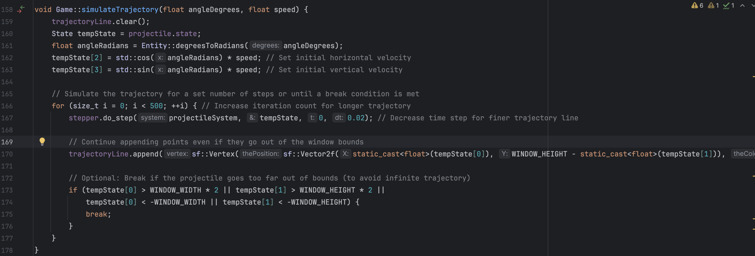
Trajectory Simulation Walkthrough

Slide 11
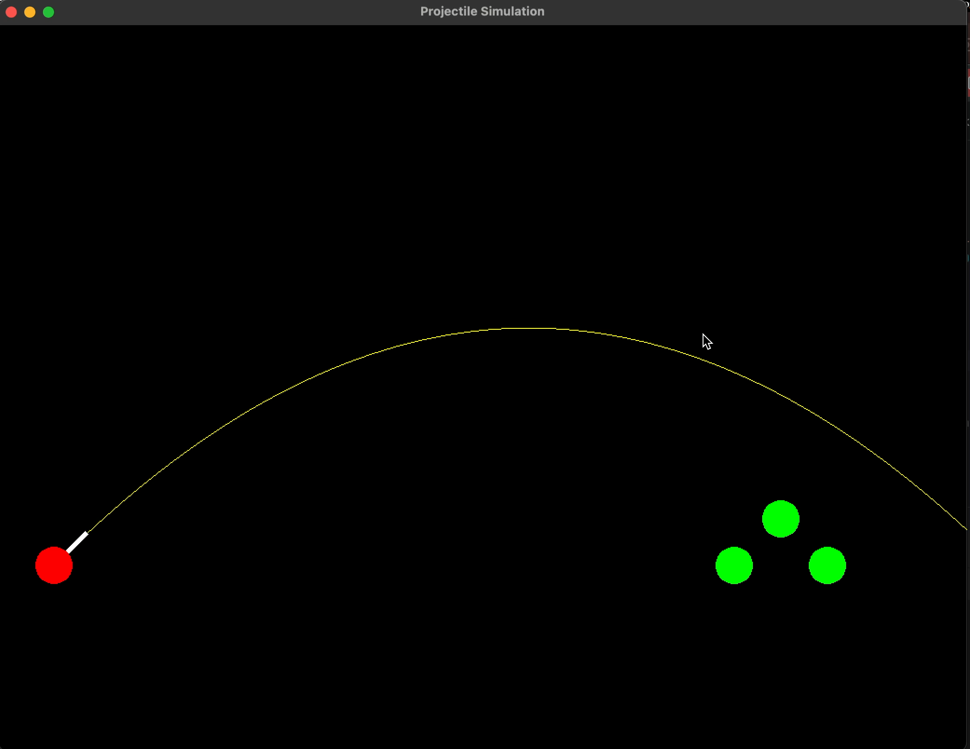
Trajectory Simulation Walkthrough
Initial Conditions: The initial velocity components (v_{x}​ and v_{y}​) are calculated from the launch angle (θ) and force (F), assuming the force directly translates to the initial speed for simplicity.
Numerical Integration: Using the RK4 method again, the function iteratively predicts the projectile's position at small time intervals (Δt) into the future.

Slide 12
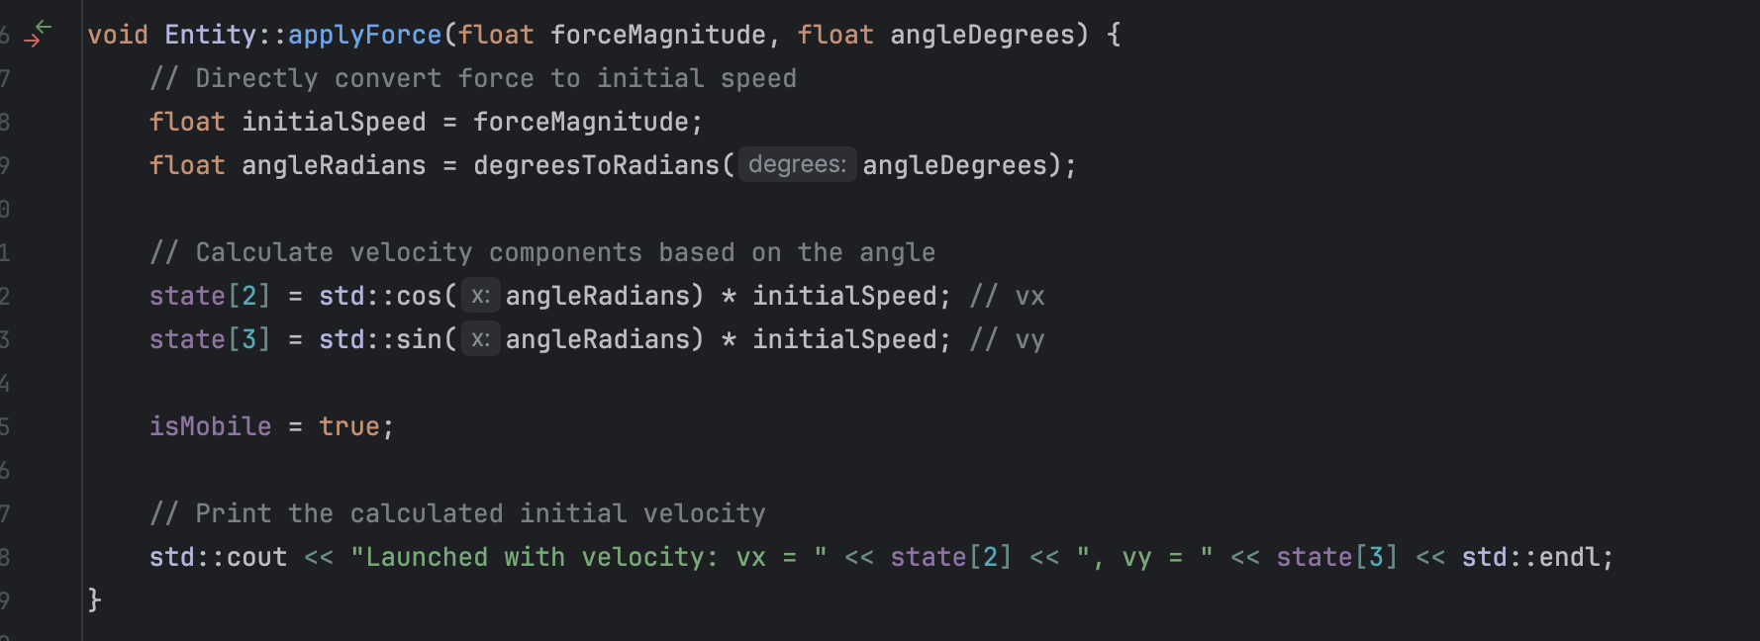
Physics: apply_Force

Slide 13
Physics: apply_Force
Initial Speed: The method assumes that the force magnitude directly translates to an initial speed. In reality, to find the initial speed from a force, I would use a=F/m​ to find acceleration, then integrate this acceleration over the time the force is applied to find the speed.
Angle Conversion: The angle of the force is converted from degrees to radians because trigonometric functions in most programming languages use radians. The conversion formula is radians=degrees× π​/180.
Velocity Components: The initial velocity components (v_{x}​ and v_{y}​) are calculated using trigonometry as v_{x}​=v cos(θ) and v_{y}​=vsin(θ) .

Slide 14
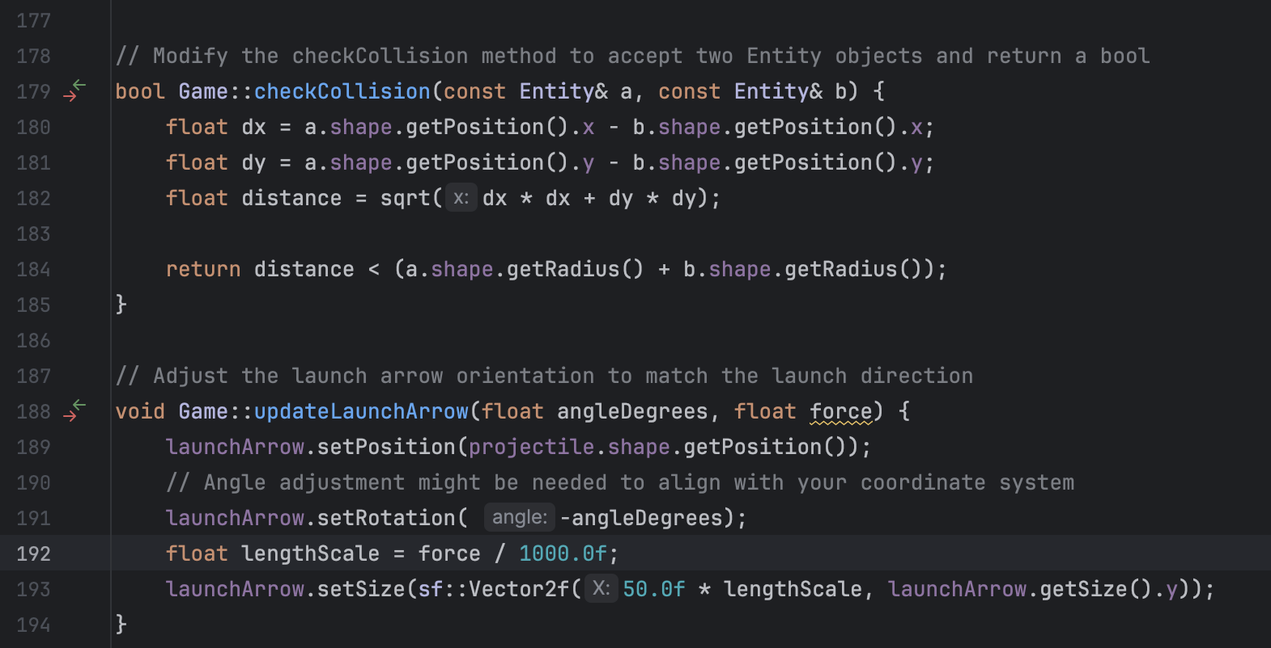
Physics: Collision

Slide 15
Physics: Collision
Calculate the Distance Between Centers: First, determine the distance between the centers of the two entities. As the entities are represented by circles, this involves calculating the Euclidean distance between their center points.
Let (x1​,y1​) be the coordinates of the first entity's center, and (x2​,y2​) be the coordinates of the second entity's center.
The distance d between the centers is calculated as:
d=√ ((x2​−x1​)²+(y2​−y1​)^{2​})
Angle Conversion: The angle of the force is converted from degrees to radians because trigonometric functions in most programming languages use radians. The conversion formula is radians=degrees× π​/180.
Velocity Components: The initial velocity components (v_{x}​ and v_{y}​) are calculated using trigonometry as v_{x}​=v cos(θ) and v_{y}​=vsin(θ) .

Slide 16
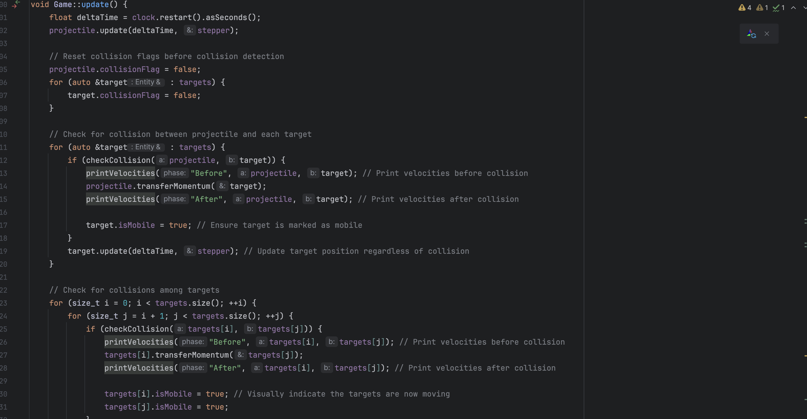
Physics: Collision_between P <-> T <->T

Slide 17
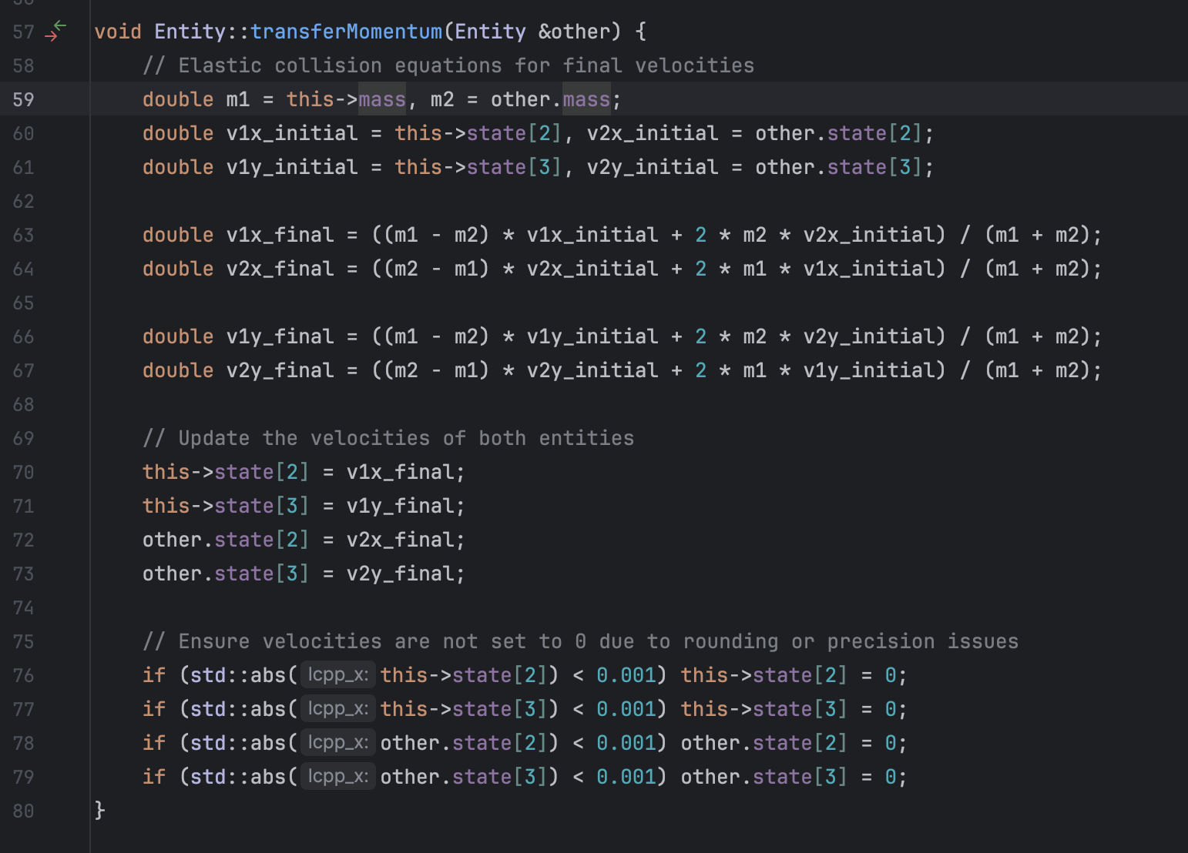
Physics: Transfer Momentum

Slide 18
Physics: Collision
Momentum (p) is defined as the product of an object's mass (m) and its velocity (v), i.e., p=mv.
For a two-object system, this principle can be expressed as:
m₁​v_{1i}​+m₂​v_{2i}​=m₁​v_{1f}​+m₂​v_{2f}​
Calculating the Final Velocities for Elasticity,
For elastic collisions, the final velocities can be derived from the conservation of momentum and kinetic energy. The formulas for the final velocities (v_{1f}​ and v_{2f}​) in a one-dimensional collision are:
v_{1f}​=(m₁​−m₂ /m₁​+m₂​​​)v_{1i}​+ (2m₂ /(m₁​+m₂​)) ​​v_{2i​}
v_{2f}​= +(2m₁ /(m₁​+m₂​)) ​​v_{1i​} − (m₁​−m₂ /m₁​+m₂​​​)v_{2i}​
These formulas account for both the conservation of momentum and the conservation of kinetic energy during the collision.

Slide 19
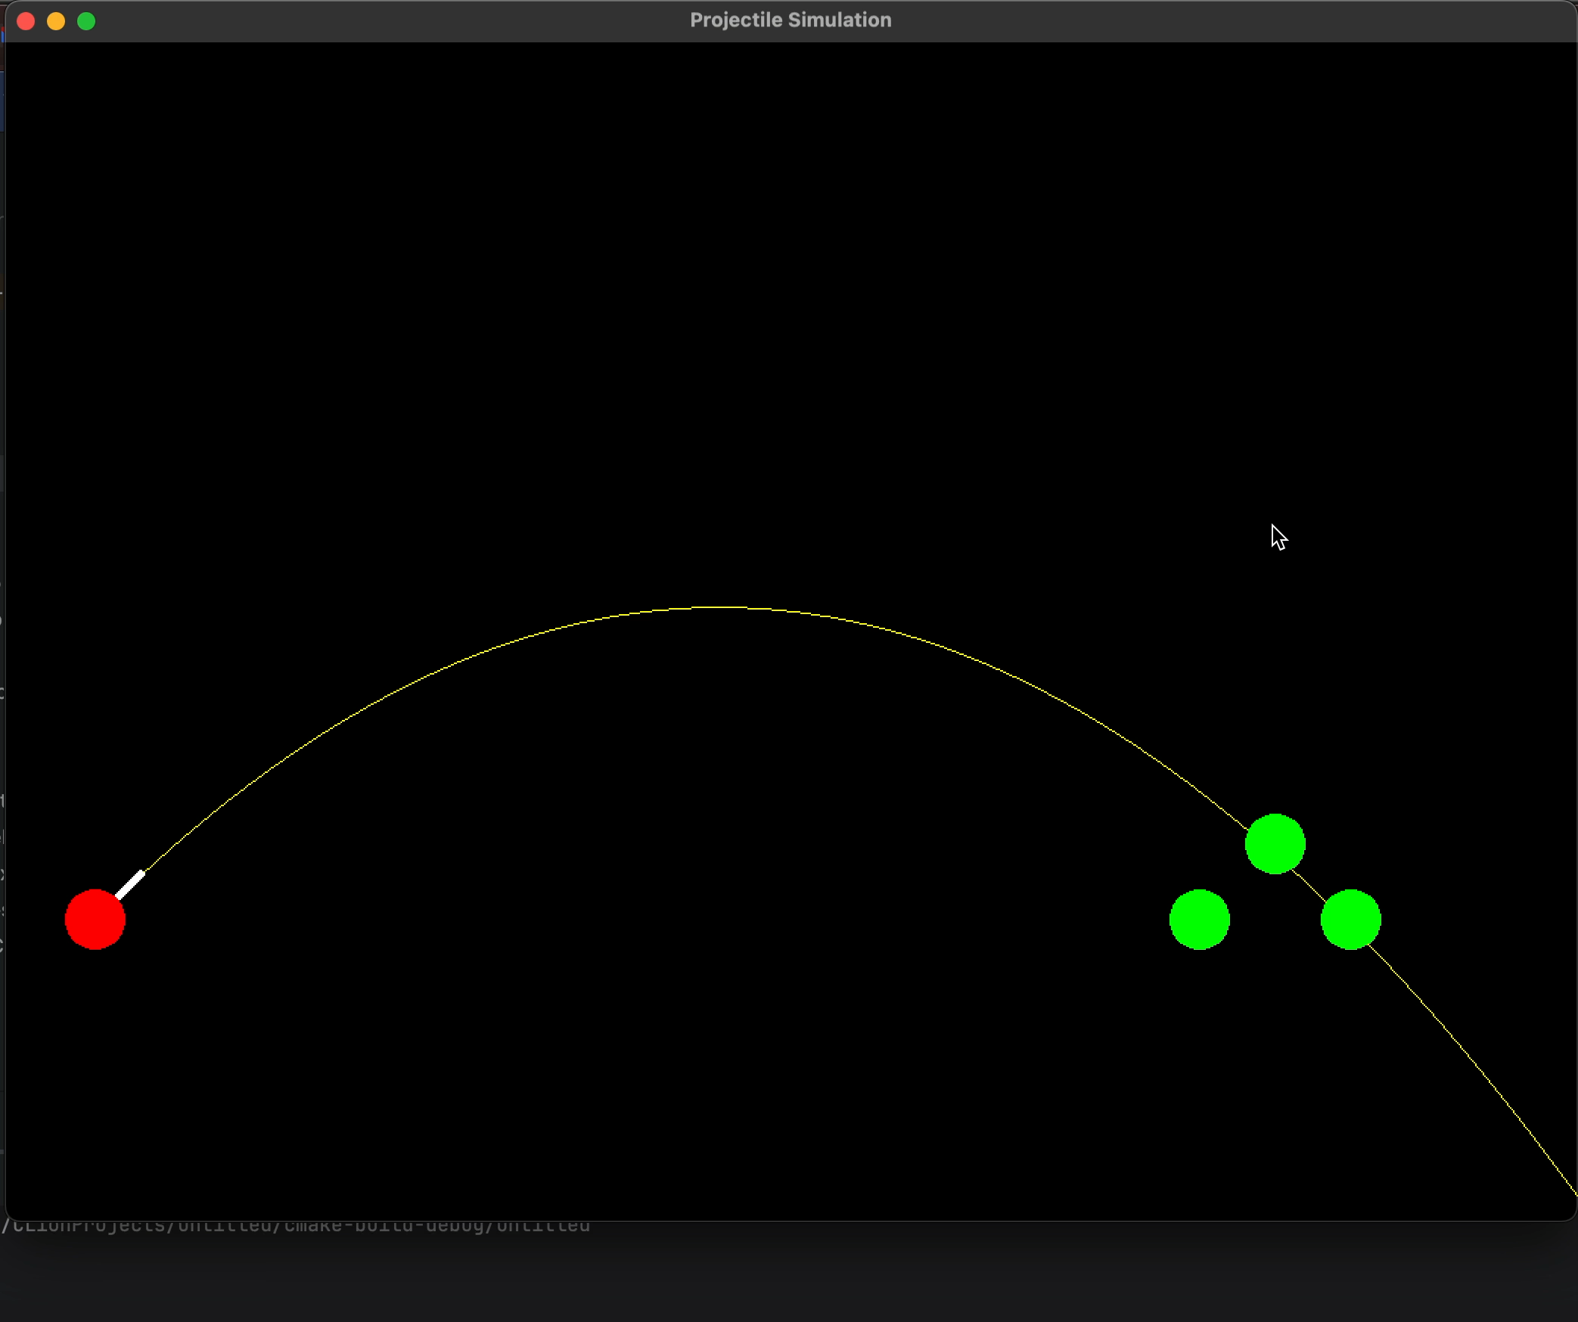
Demonstration of the Physics Computation

Slide 20
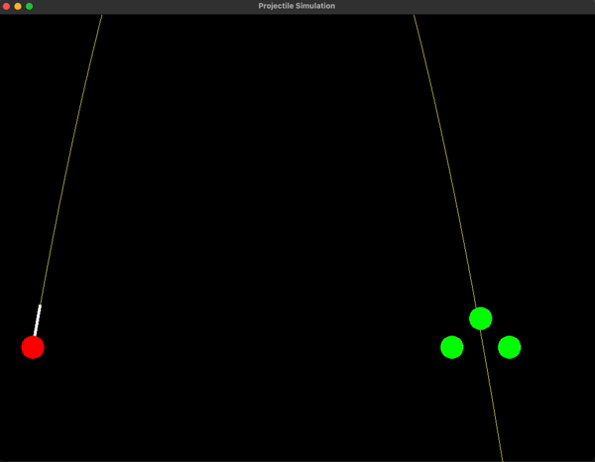
Challenges
RK4 Method.
Stepper Func.
Momentum transfer to both sides.
Collision detection among the targets.

Slide 21
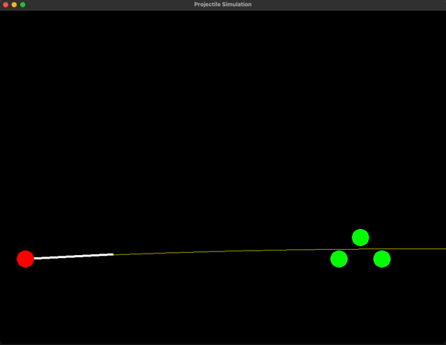
Improvements
More sophisticated Computation logic, like using piecewise functions or (Pam) to incorporate new gameplay mechanics.
More physics to play with like adding wind forces, drags,
Providing improved visuals, adding levels, time-limits to launch etc. .

Slide 22
Thank you!

Slide 23

Comments!

